Slide 1

CS 5720 - NEURAL NETWORK & DEEP LEARNING
Real-Time Pothole Detection Using Deep Learning
Journal published by : Anas Al-Shaghouri, Rami Alkhatib, Samir Berjaoui
Journal Publishing Date : July 13th 2021
Submitted by : Shiva Chaitanya Reddy Gudipati
Student Id : 700756331

Slide 2
Motivation
Finding potholes in the road is a crucial issue to tackle since it can help avert collisions, car damage, and injuries to both drivers and passengers. One of the most prevalent kinds of road faults are potholes, which can be challenging to see and avoid, particularly at night ,during Rainfall/Snowfall or in dimly lit conditions.
Manual inspections are a common component of traditional pothole detection techniques, however they can be laborious and ineffective(would take long time to detect). Deep learning automation of this process can greatly increase efficiency by swiftly scanning roadways and locating places that require repair.
The issue of potholes is widespread in both industrialized and underdeveloped nations. Because your project offers a solution that can be applied in many places, independent of their level of infrastructure development, it has the potential to have a worldwide influence.

Slide 3
Problem Statement
As we all know how Potholes play a role in causing most of the minor and some major accidents across the globe, having potholes on the roads are very dangerous in any climate.
Since it can cause a very serious damage to vehicle’s and even the drivers which can make the vehicle fall apart and causing serious injuries.
So, here is a Pothole detection project which allows us to solve the problem of avoiding potholes where the model which we have generated using transfer learning.

Slide 4
Objective
To identify potholes on the road and prevent collisions.This methodology has the potential to assist road maintenance agencies in devising prompt and efficient measures for repairing road infrastructure.
Provide an easy-to-use interface so that operators may effectively prioritize repair operations and show detected potholes.
Measure the accuracy, dependability, and cost-effectiveness of the system by conducting extensive testing and evaluation.

Slide 5
Contribution
Data collection: Road images are collected using cameras mounted on vehicles or drones. The images are captured from different viewpoints and lighting conditions to make the dataset diverse.
Data preprocessing: The collected images are preprocessed to remove any noise or distortion. This may involve resizing the images to a fixed size, applying filters to reduce noise, and adjusting the contrast and brightness to improve visibility.
Transfer learning: A pre-trained ResNet50 model is used as a feature extractor to extract features from the preprocessed images. The output from the ResNet50 model is flattened and fed into a fully connected layer to classify whether a pothole is present or not.
Fine-tuning: The last few layers of the ResNet50 model are fine-tuned using the collected dataset to improve the model's accuracy in detecting potholes.
Training: The fine-tuned ResNet50 model is trained using the collected dataset to optimize the model's parameters for pothole detection.
Testing and evaluation: The trained model is tested on a separate set of images to evaluate its accuracy in detecting potholes. Various metrics such as accuracy, precision, recall, and F1 score are used to evaluate the model's performance.

Slide 6
Proposed Solution
The Pothole Detection model, Resnet50, can be connected with autopilot vehicle modes to enable the vehicle to avoid potholes. It is used to figure out whether or not there are any potholes on the roads.
A reliable and precise system for detecting potholes on the road's surface is capable of being created by utilizing ResNet50's capabilities. The resultant system will be able to recognize potholes with extreme accuracy.
To provide real-time detection and alerts to drivers or road maintenance staff, this system can be connected with already-existing road monitoring systems, such as cameras mounted on vehicles or drones.

Slide 7
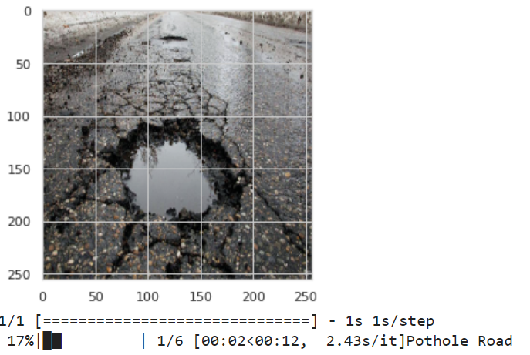
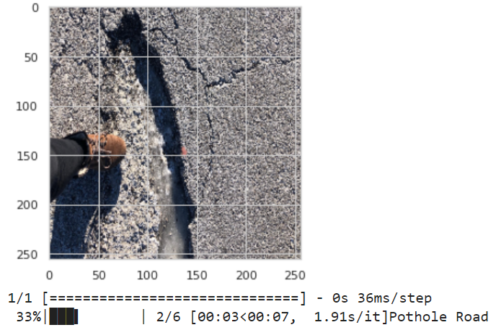
Results

Slide 8
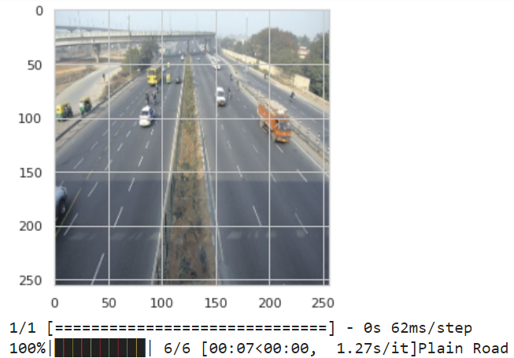
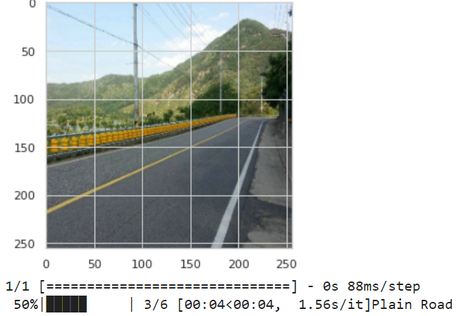
Results

Slide 9
References
R. Rastogi, U. Kumar, A. Kashyap, S. Jindal and S. Pahwa, "A Comparative Evaluation of the Deep Learning Algorithms for Pothole Detection," 2020 IEEE 17th India Council International Conference (INDICON), 2020, pp. 1-6, doi: 10.1109/INDICON49873.2020.9342558.
A. Kumar, Chakrapani, D. J. Kalita and V. P. Singh, " Pothole Detection technique using Deep Learning," 2nd International Conference on Data, Engineering and Applications (IDEA), Bhopal, India, 2020, pp. 1-5, doi: 10.1109/IDEA49133.2020.9170705.
A. B. Rani and T. M. Thirumalaisamy, "Pothole detection using transfer learning with ResNet50," 2019 IEEE International Conference on Innovative Research and Development (ICIRD), Kolkata, India, 2019, pp. 1-5, doi: 10.1109/ICIRD.2019.8909629.

Slide 10
References
G. B. R., C. C., S. B. Rao M., S. M., K. E. and S. J., "Deep Learning Based Pothole Detection and Reporting System," 2020 7th International Conference on Smart Structures and Systems (ICSSS), 2020, pp. 1-6, doi: 10.1109/ICSSS49621.2020.9202061.
A. Kumar, Chakrapani, D. J. Kalita and V. P. Singh, " Pothole Detection technique using Deep Learning," 2nd International Conference on Data, Engineering and Applications (IDEA), Bhopal, India, 2020, pp. 1-5, doi: 10.1109/IDEA49133.2020.9170705.
N. U. Hasan, M. I. Ullah, and M. A. Hossain, "Pothole detection using transfer learning with ResNet50," 2020 5th International Conference on Electrical and Electronics Engineering (ICEEE), Dhaka, Bangladesh, 2020, pp. 1-6, doi: 10.1109/ICEEE49640.2020.9089754.

